Slide 1

International Conference on Social Development and Sustainability x Philippine Human Ecology Consortium
Central Mindanao University (located on Mindanao Island in Bukidnon province, Philippines)
November 18-19, 2025

Slide 2
Conference Theme https://dsds.che.uplb.edu.ph/sdcon/2025-icsdsxphec/
Social Development and Sustainability for Human Ecological Well-being

Slide 3

The conference goal is to expand the sharing and discussion of research and practices pursuant to human ecological well-being within the social development and sustainability nexus.
“A nexus is more than an intersection. It is an important connection between a series of elements comprising a system of thought. Its role is to bind things together” (Gibbs & McGregor, 2023, p. 2).
In this case, the elements comprising the thought system are social development, sustainability, and human ecological well-being.
Work within this nexus will depend heavily on engaging diverse stakeholders in collaboration as they explore partnerships to strengthen human organizations and social institutions toward social development and sustainability to ensure human ecological well-being.

Slide 4
KEYNOTE: Augmenting a Social Development and Sustainability Nexus for Human Ecological Well-Being with Transdisciplinarity
Sue L. T. McGregor
PhD, PHEc, IPHE, Professor Emerita (MSVU)
Sue.mcgregor@msvu.ca
www.consultmcgregor.com

Slide 5
Conference Premise
Human ecological well-being can be improved if we focus on sustainability and social development relative to economic and human development.
I have added transdisciplinarity to the mix.

Slide 6

Let’s unpack this premise…

Slide 7
Economic Development
Develop the economy (i.e., the system by which a country or region produces, trades, and uses goods and services)
Economic development depends on policy initiatives that affect a nation’s income and wealth leading to degrees of growth, progress, and prosperity.
Economic growth depends on people’s capabilities related to economic activities — in other words, human development, which has two meanings.

Slide 8
Human Development (2 meanings)
Human capital -people’s skills, knowledge, capabilities, and attributes that affect their contribution to the nation’s economic life as measured by the Gross Domestic Product (GDP)
Measure of human well-being along three key dimensions (UN):
(a) life expectancy at birth;
(b) education (expected years of schooling, and mean years of schooling received); and
(c) per capita income

Slide 9
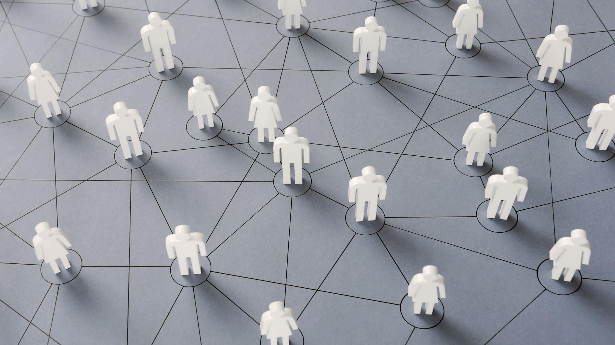
The crux of the conference theme is how social development and sustainability shape human ecological well-being

Slide 10

Social Development
Those developing the economy should also strive to develop society so there is/are
(a) economic stability, security, and satisfaction;
(b) political freedom and stability;
(c) a voice in government;
(d) basic human rights;
(e) an equitable and just society;
(f) freedom to make choices; and
(g) the ability to engage in daily activities free from fear of persecution or crime.

Slide 11
Sustainability
The 1987 UN Brundtland Commission defined sustainability as meeting the needs of the present without compromising the ability of future generations to meet their own needs.
NOTE: virtually all 17 UN Sustainable Development Goals (SDGs) concern aspects of social development:
poverty, education, food security, well-being and good health, education, clear water and sanitation, housing security, decent work, gender equality, and strong social institutions

Slide 12
Four Pillars of Sustainability
Social
Economic
Cultural
Environmental
When these pillars start to crumble due to unsustainability, human resiliency and well-being are compromised.

Slide 13
Human Ecological Well-being
Home economics is deeply familiar with the well-being, human ecology, and human ecosystems constructs, BUT we don’t use the term human ecological well-being … well, at least not until this conference!
The UN and subsequent scholars conceptualized the human ecological well-being construct as dealing with
(a) the impact of ecosystem services on human well-being and
(b) the impact of human actions on ecosystems so their services to humans can continue (services to ecosystems).

Slide 14

While human ecology and human ecological well-being are both based on reciprocity, the latter differs in that it employs the notion of ecosystem services to accommodate exchanging things for mutual benefit.

Slide 15

Ecosystem services
are the benefits that people obtain from ecosystems:
provisioning services such as food, water, timber, fuel, and fiber;
regulating services that affect climate, floods, disease, wastes, and water quality;
cultural services that provide recreational, aesthetic, and spiritual benefits; and
supporting services such as soil formation, photosynthesis, and nutrient cycling.

Slide 16
Ecological services and services to ecosystems meet five dimensions of human ecological well-being:
(a) security (personal safety, resource access, clean and secure living spaces, and low environmental threats);
Akin to physical, and environmental well-being
(b) basic material for the good life (income, livelihood, shelter, food, and access to goods and services);
Akin to economic, and physical well-being
(c) health (strength, feeling well, clean air and water, adequate nutrition, and disease protection);
Akin to physical, and environmental well-being
(d) good social relations (culture, spiritual, aesthetics, and recreational); and
Akin to social, spiritual, and psychological (emotional) well-being
(e) freedom of choice and action (i.e., political autonomy).
Akin to political well-being

Slide 17
My letter of invitation triggered my thoughts about augmenting the nexus with transdisciplinarity:
“This conference will bring together civil society, practitioners, policymakers, researchers, academia, and experts from across the nation to discuss research and practices that highlight social and community innovations, collaborations, and partnerships toward social development and sustainability. The participation of academic, research, and development institutions and organizations will significantly stimulate the exchange of ideas and engage various stakeholders in the collaborative sharing of experiences, lessons learned, best practices, and innovations to current opportunities and challenges within the intersection of social development and sustainability.”

Slide 18

Each of the five conference subthemes depends on collaborative partnership efforts among various sectors, so participants can gain a deeper appreciation for intergenerational social justice and sustainability as they affect human ecological well-being and security – these inherently involve transdisciplinarity.

Slide 19
Conference themes:
Incorporate social innovations, and technologies into social development programs, so the latter promote well-being
Collaborative climate action and disaster risk management to bolster resilience
Decent work, ecocultural livelihoods, and inclusive tourism highlight reciprocal relationships between social systems and nature/ecosystems that contribute to justice and equity
Social and ecological determinants of health (i.e., social and ecological factors are connected to health and well-being)
Food and nutrition systems for human ecological well-being (based on home economics’ human ecological perspective)

Slide 20
Transdisciplinarity – between, among, and beyond academic disciplines to include all sectors – disciplines, government, industry, and civil society.

Slide 21
Four approaches to transdisciplinarity (began in the 1970s) Most focus on “The whole” while dealing with complexity and reconciling contradictions
Late 1980s
Nicolescu’s (Romanian theoretical quantum physicist) methodology for creating holistic and integrated knowledge informed by 3 philosophical axioms: (a) multiple levels of Reality (subjective and objective) mediated by the Hidden Third; (b) complex, embodied, and emergent knowledge; and (c) inclusive and complexity logics (some people add transdisciplinary values – axiology)
2001
Zurich pragmatic approach (solidified at a conference) of doing science with society aided by technology and drawing on already-existing Mode 2 knowledge production and postnormal science
1990s Russian language with 2020s English translation
Russian philosopher framed TD as a new metadiscipline that trains systems transdisciplinary generalists to use a specially developed Unicentric philosophy to address the essence that threads through everything (rather than holism)
2011 onward (still evolving)
Brazilian TD theory for public administrators and policy makers to create feasible, rational, reasonable, and intuitive public policy through a dialogue of opposites leading to holism

Slide 22

What this means for home economists in particular:
Transdisciplinarity pushes home economists to move beyond
(a) working with individuals and families while drawing on other disciplines (multi and interdisciplinarity)
to
(b) working with individuals and families while drawing on other disciplines as well as government, industry, and civil society sectors.
This necessitates the collaboration, inclusion, and integration of many voices — a central goal of this conference.

Slide 23
What would transdisciplinary work entail? Home economists – indeed all stakeholders - would
Deal with complexity
Focus on patterns
Appreciate intellectual fusion
Respect, expect, and accommodate contradictions, antagonisms, resistance, and closed mindedness and anticipate emergence
Apply inclusive logic and complexity logic (not just exclusive deductive or inductive logics)
Seek transdisciplinary values that supersede individuals’ values

Slide 24

Complexity
Compared to complicated, which is intricate and detailed and static, complexity is intricate and detailed and emergent (continually coming into existence) with evolving connections, patterns, structures, and properties.
Complex entails interwoven or braided strands defined by how they are connected - by their relations - not by their own static traits; the latter is superseded by emergence.

Slide 25
Focus on Patterns
Rather than accepting separate and parallel streams of information, ideas, and perspectives from diverse stakeholders, the newly formed TD collective looks for patterns of integrated knowledge, which is created by synthesizing the different streams into a more holistic view of and ways to address complex, wicked problems.

Slide 26
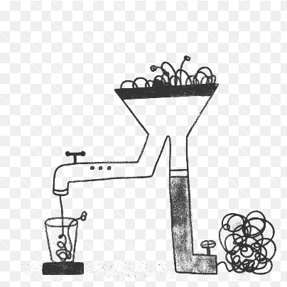

Slide 27

Appreciate Intellectual Fusion
“Intellectual fusion involves bringing together, into a single entity, different aspects of the intellect (or different ways of thinking or knowing across various academic or intellectual traditions)” (Thomas, ca. 2025).
If the effort is well managed and lead, people can think faster and differently when exposed to each other than when working alone; the resultant intellectual fusion (fusion of diverse thoughts) is a collaborative effort where a positive, enabling energy is given off that helps consolidate things.
Separate, diverse people can fuse into a new whole and cocreate new, fused knowledge.

Slide 28
ACCEPT and expect contradictions, antagonisms, resistance, and closed mindedness
Due to the profound diversity of transdisciplinary groups (knowledge, perspectives, opinions, interests, resources, goals, and values), and an ingrained inclination to protect one’s own interests, stakeholders must respect, expect, and accommodate contradictions, antagonisms, resistance, and closed mindedness while presuming that something new will eventually emerge.
With this respect, stakeholders can learn to rely on the safety of the evolving collective of actors and the hidden potential ready to unfold rather than the certainty and restrictedness of sector-based expertise, especially disciplinary expertise.
Stakeholders will learn to anticipate and work through (a) uncertainty; (b) chaos (order emerging, just not predictably); (c) risk; and (d) respect tension as resistance that can be overcome – it holds things together as something emerges rather than pushes things apart.

Slide 29
Use inclusive logic and complexity logic
Exclusive logic assumes there is no room for contradictions — “either/or thinking” (two things cannot be true at the same time) – it is or it isn’t, but it cannot be both
TD logics assume that two or more things can be recognized as individually different in nature, quality, or identity, yet still be intrinsically connected, interrelated, or part of a larger whole -- “both/and thinking” (two things can be true at the same time)
Inclusive logic facilitates the temporary reconciliation of contradictory viewpoints so that strategic and innovative ideas can be jointly formulated.
Complexity logic braids the elements (ideas) formulated when using inclusive logic into something new that is agreed to and then implemented.

Slide 30
Transdisciplinary Values
Transdisciplinary work is shaped, driven, and accomplished through transdisciplinary values.
Individuals’ values initially inform interactions among diverse actors.
However, during collaboration, these values are eventually superseded by an agreed-to value set comprising humanistic values that keep the dialogue and cocreation moving forward:
humility, respect, trust, empathy, compromise, tolerance, accountability, collective wisdom, commitment, and collegiality.

Slide 31
What type of knowledge is cocreated during TD work? TD knowledge is…
Subjective and objective cojoined by a lubricating, mediating force*
Complex *
Emergent and alive - always in formation – never static
Embodied - owned by everyone who cocreated it
Cross-fertilized - development stimulated through exchange and mixing of different knowledge, experiences, ideas, interpretations, and expertise
Contextual or in situ - created where it will be applied; its meaning and relevance come from the surrounding circumstances, situation, or environment
Socially robust and socially approved - meets criteria of justice, fairness, effective, efficacy, autonomy; accepted by actors in the social and political context of its application
Socially accountable - diverse and myriad actors are fully aware of how different societal stakeholders will be affected and assume responsibility for and justify its cocreation (i.e., provide reasons)

Slide 32

Subjective and objective knowledge cojoined by a lubricating, mediating force
A blend of opposites — more than just objective knowing regardless of the sector (facts, statistics, information, formulae), TD knowledge also reflects people’s subjective perspectives and consciousness (their opinions and interpretations);
Help is normally required to bring these two realms together — a mediating or lubricating force to soften or lower mental boundaries, so minds can open, and resistence can lessen:
Music, art, theatre, religion, culture, the Sacred (connection with nature),faith, and spirituality

Slide 33
Nicolescu calls this force the Hidden Third
TD-SUBJECT
Internal Level of Reality
Internal contextual world of humans where subjective perspectives and consciousness flow
individual (psychological and philosophical)
HIDDEN THIRD operating in the ZONE OF NONRESISTANCE (Included Middle)
Mediating force lubricating the movement (flow) between internal and external Realities in a zone where people remain open to each other
religions (external organized) and faith (belief in someone or in a higher power)
TD-OBJECT
External Level of Reality
External world of humans where objective information flows
economics (includes law, and business)
political (includes ideological)
planetary (planet, global, worldwide)
spirituality (internal meaning; connect to something larger than self)
culture and the Arts
environment (and ecology)
cosmic (universe, multiverse)
technology (includes science, and medicine)
family and kinship
geographical (local, national, regional)
historical
social, and collective (community)
These are not Realities; instead, they cross all levels of Reality acting as spirit-and-mind-opening, unifying modalities using inclusive and complexity logics leading to a new trans-Reality for a given context
the Sacred (connect with nature)

Slide 34
TD knowledge is complex
Complex is nonlinear (no straight lines) meaning the interwoven strands are defined in relation to what they are connected to instead of defined by their individual characteristics (simple - unconnected).
Complex TD knowledge comprises interwoven, interlaced strands of divergent information and perspectives from many sectors rather than standalone sector-bound only.

Slide 35
What type of knowledge is cocreated during TD work? TD knowledge is…
Subjective and objective cojoined by a lubricating, mediating force
Complex
*Emergent and alive - always in formation – never static
Embodied - owned by everyone who cocreated it
Cross-fertilized - development stimulated through exchange and mixing of different knowledge, experiences, ideas, interpretations, and expertise
Contextual or in situ - created where it will be applied; its meaning and relevance come from the surrounding circumstances, situation, or environment
Socially robust and socially approved - meets criteria of justice, fairness, effective, efficacy, autonomy; accepted by actors in the social and political context of its application
Socially accountable - diverse and myriad actors are fully aware of how different societal stakeholders will be affected and assume responsibility for and justify its cocreation (i.e., provide reasons)

Slide 36


Slide 37

Wrap up with a cake metaphor…
“One starts with a wide-ranging set of ingredients that are all different yet must somehow be combined to attain the final product. The ingredients are blended and mixed (respecting their contradictory nature), and then this mixture is allowed to bake thus forming a totally new entity. The intermixing and baking involve both external and internal activity or chemistry. Things are not coordinated by one person but emerge naturally as in complex adaptive systems. Once baked, the cake comprises all the original ingredients, but it is virtually impossible to identify them anymore, and the cake is totally different from the original input. Indeed, the cake (a unity of disparate parts) supersedes the ingredients” (McGregor, 2024, p. 306).

Slide 38
I leave you with a different way to think about what collaboration and emergent knowledge might look when cocreated through a transdisciplinary lens thus better ensuring that conventional and human ecological well-being are achievable through a social development/sustainability nexus.

Slide 39
Key references for human ecology, human ecological well-being, and transdisciplinarity
Comberti, C., Thornton, T. F., De Echeverria, V. W., & Patterson, T. (2015). Ecosystem services or services to ecosystems? Valuing cultivation and reciprocal relationships between humans and ecosystems. Global Environmental Change, 34, 247–262. https://doi.org/10.1016/j.gloenvcha.2015.07.007
McGregor, S. L. T. (2010a). Historical notions of transdisciplinarity in home economics. Kappa Omicron Nu FORUM, 16(2). http://www.kon.org/archives/forum/16-2/mcgregor.html
McGregor, S. L. T. (2010b). Integral leadership and practice: Beyond holistic integration in FCS. Journal of Family & Consumer Sciences, 102(1), 49–57.
McGregor, S. L. T. (2023). Transdisciplinarity and public policy: Nicolescuian, Zurich, and Brazilian approaches. Transdisciplinary Journal of Engineering and Science, 14, 47–63. doi:10.22545/2023/00219
McGregor, S. L. T. (2024b). Russian school of transdisciplinarity as a metadiscipline. Universum: Social Sciences, 3(106), 53–65. https://7universum.com/ru/social/archive/item/17087
McGregor, S. L. T., & Goldsmith, E. B. (1998). Extending our understanding of quality of life, standard of living, and well-being. Journal of Family & Consumer Sciences, 90(2), 2–6, 22.
Millennium Ecosystem Assessment. (2005). Ecosystems and human well-being: Synthesis. Island Press. https://www.millenniumassessment.org/documents/document.356.aspx.pdf

